Slide 1


데이터 자료를 이용한 EPL 시각화 분석 프로젝트

Slide 2
EPL 무엇일까요?

Slide 4
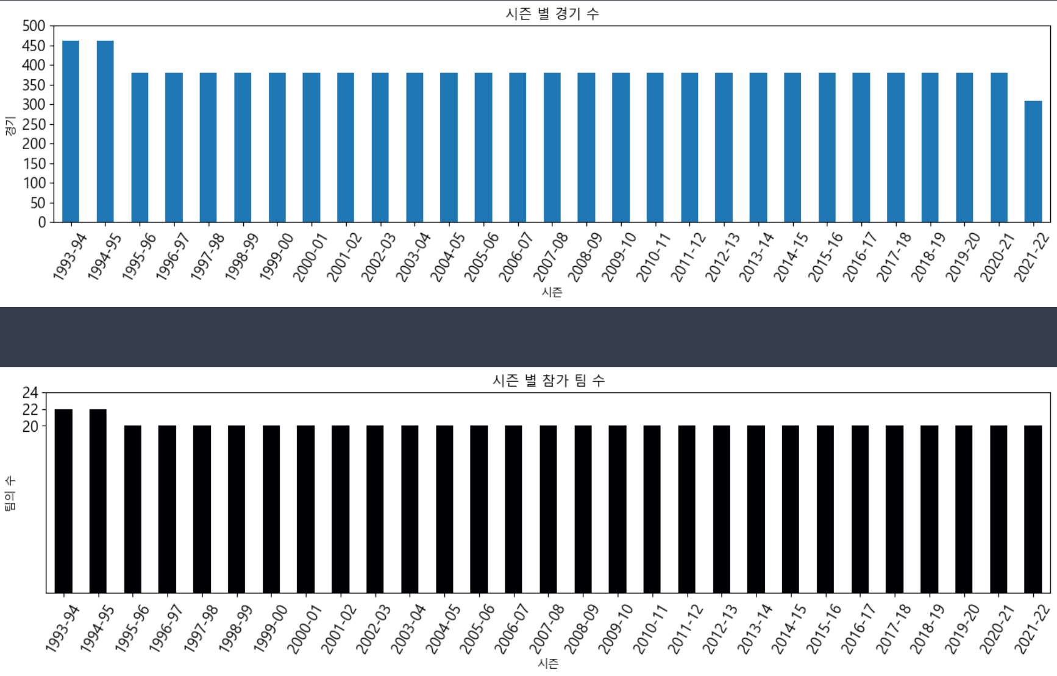
PPT PRESENTATION
Enjoy your stylish business and campus life with BIZCAM

Slide 5
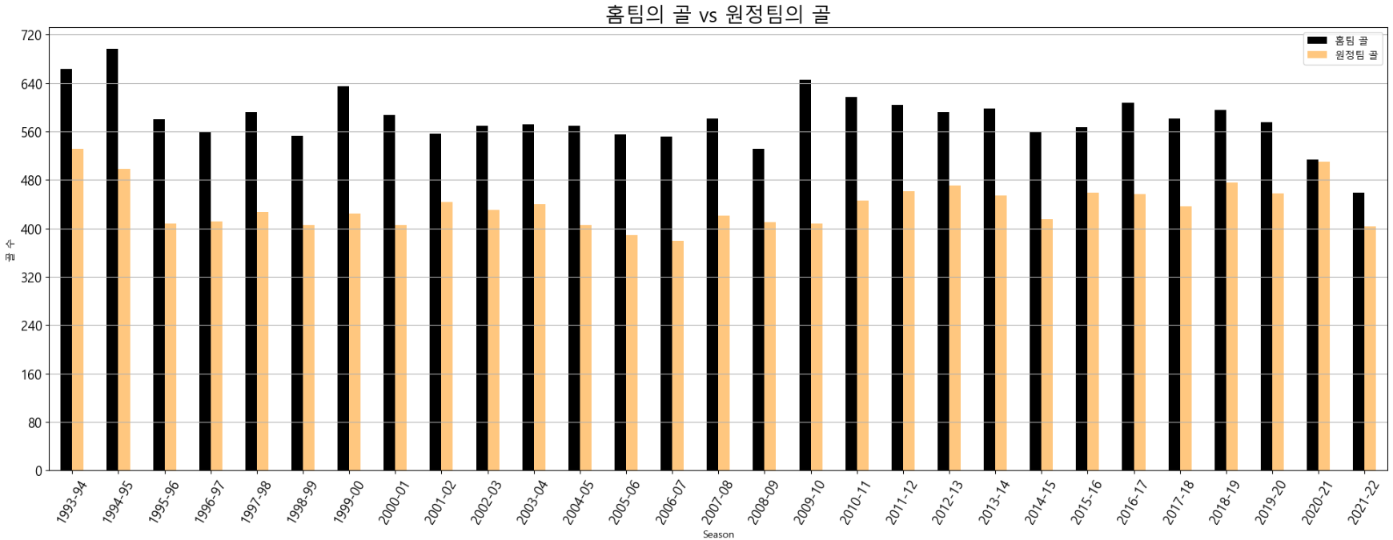
PPT PRESENTATION
Enjoy your stylish business and campus life with BIZCAM

Slide 6
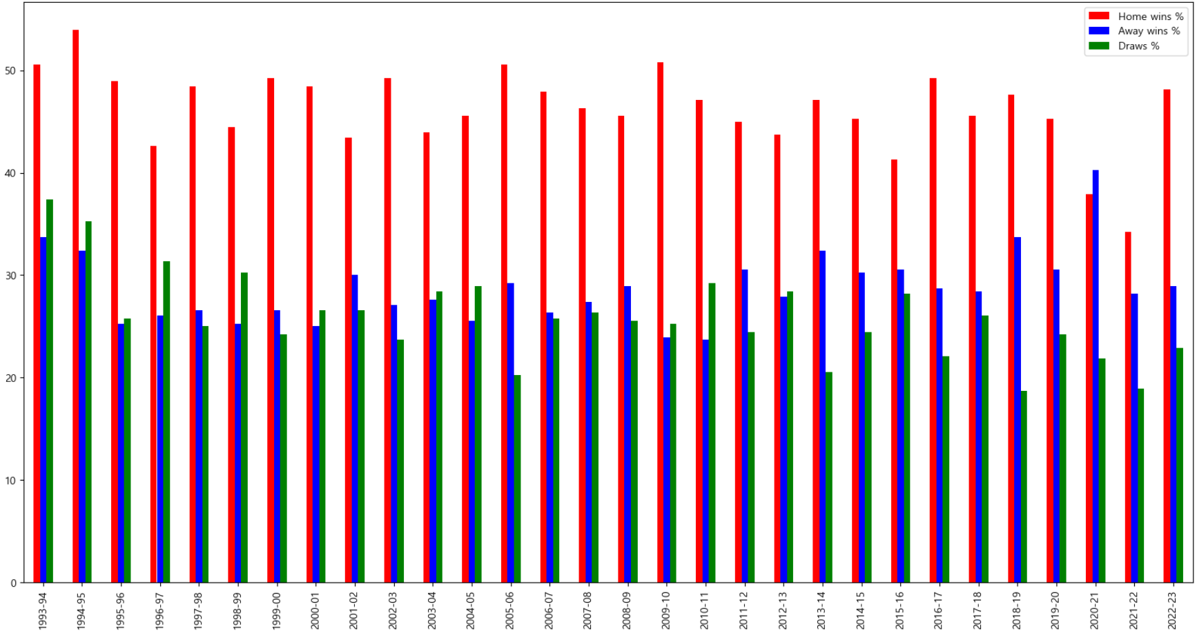
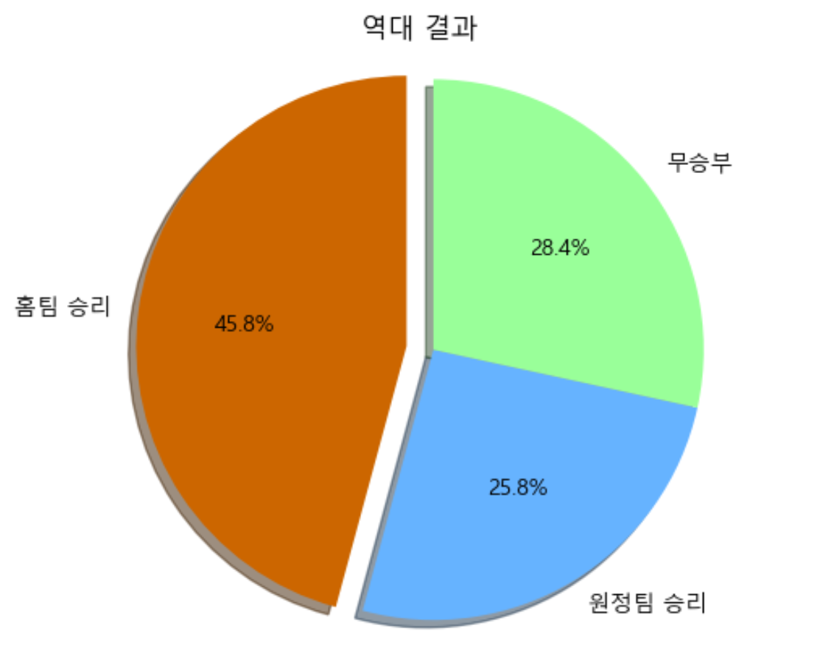
PPT PRESENTATION
Enjoy your stylish business and campus life with BIZCAM

Slide 7
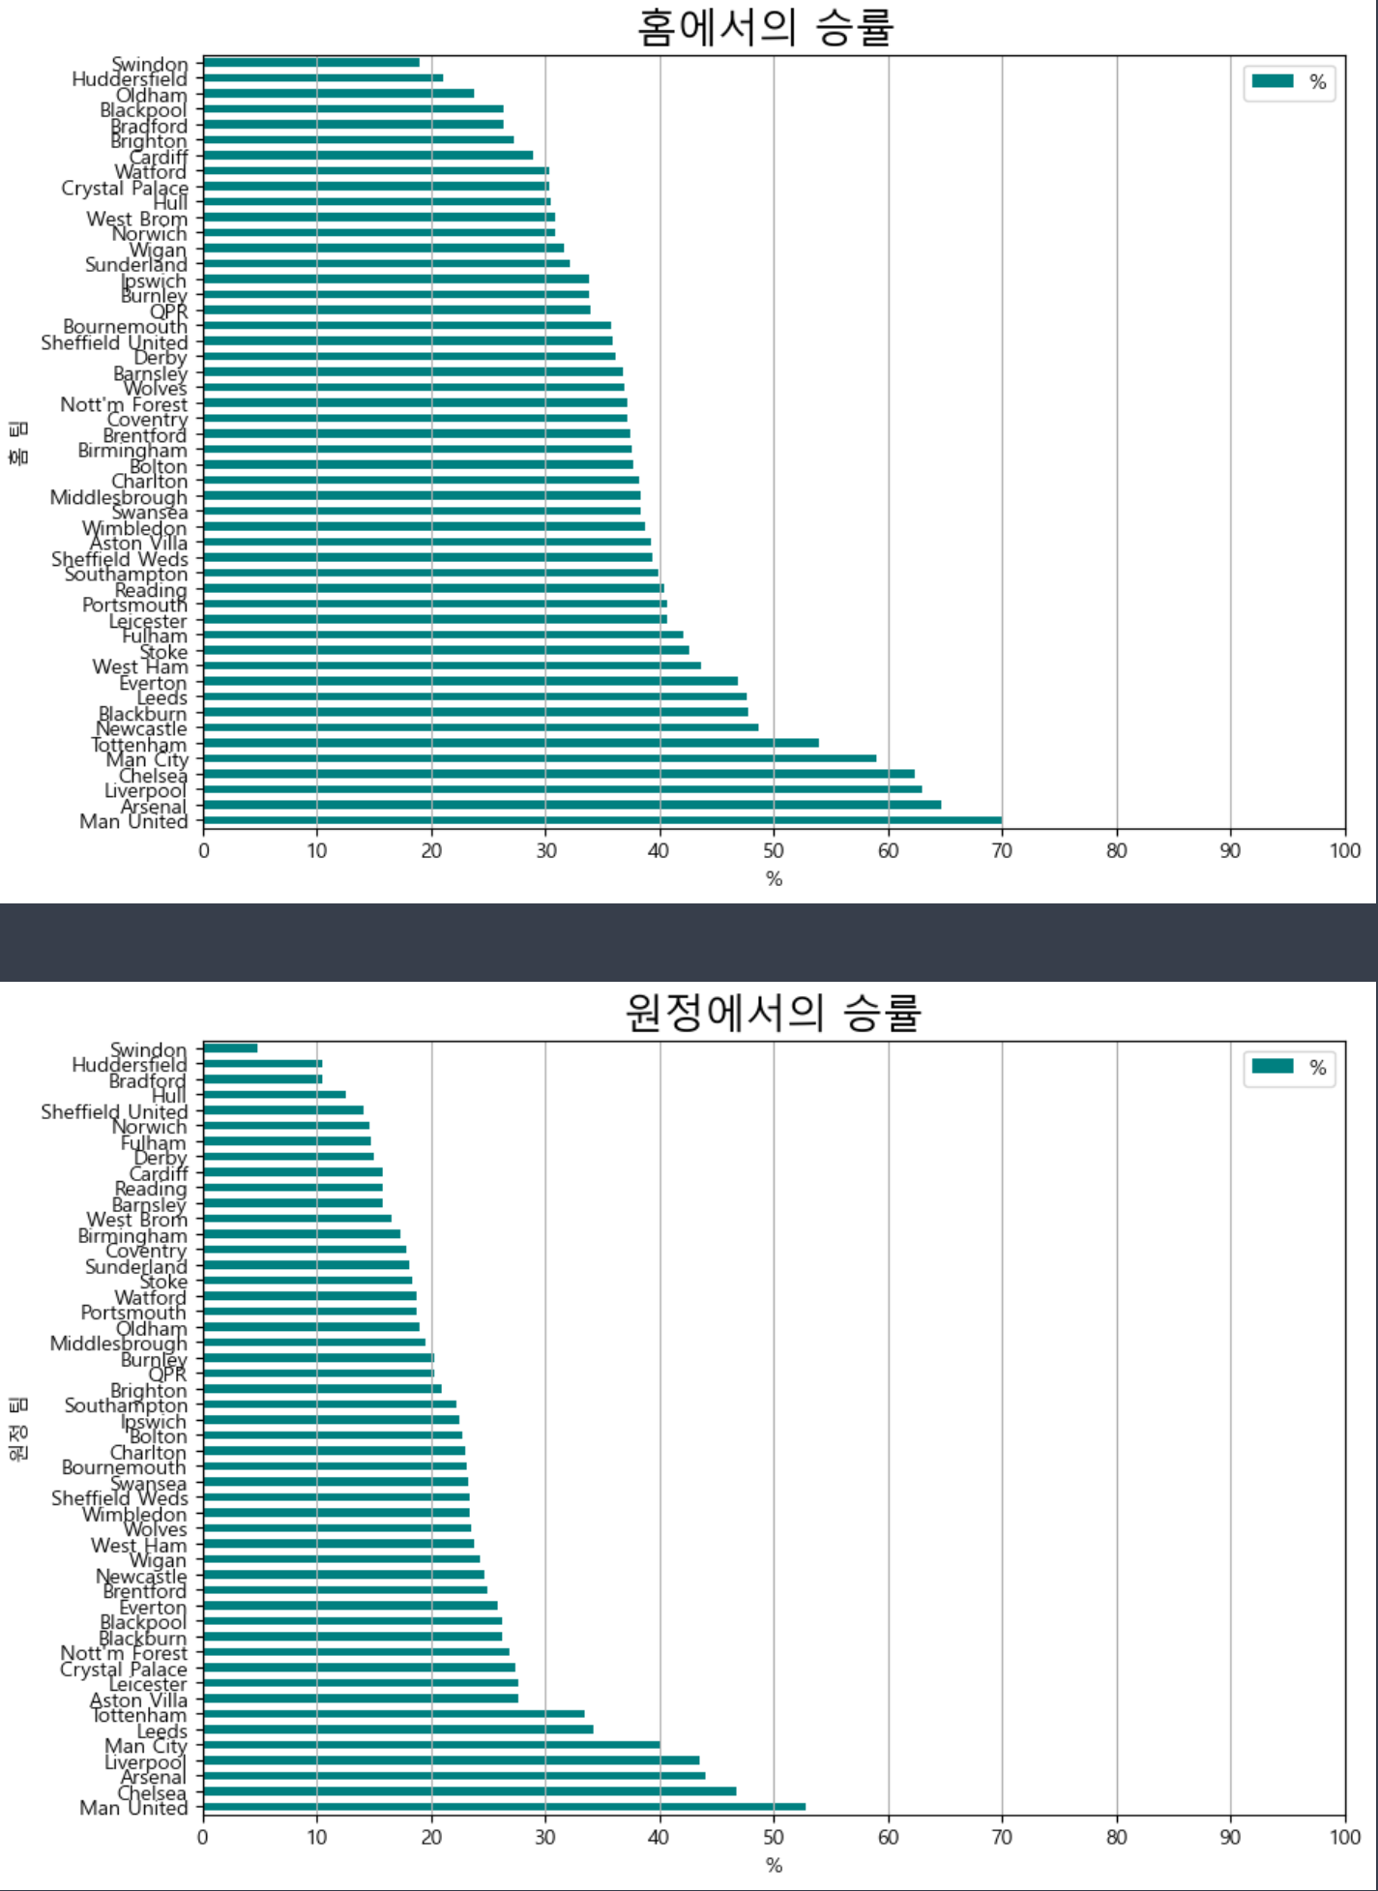
PPT PRESENTATION
Enjoy your stylish business and campus life with BIZCAM

Slide 8
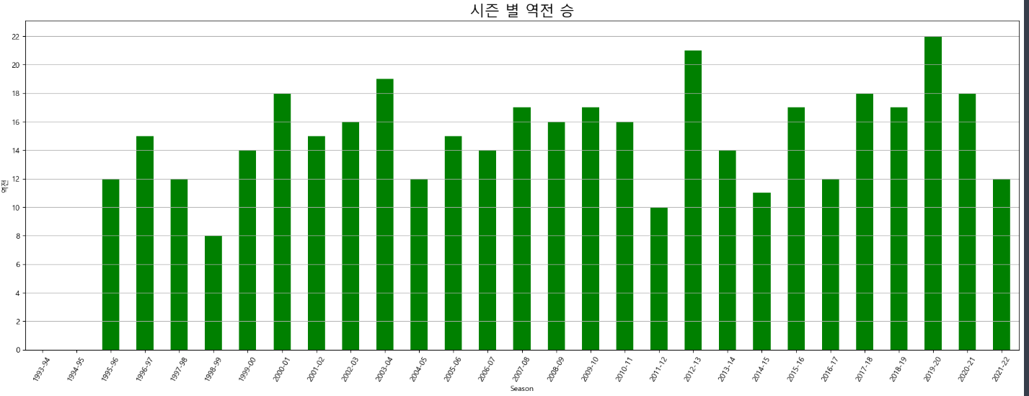
PPT PRESENTATION
Enjoy your stylish business and campus life with BIZCAM

Slide 9
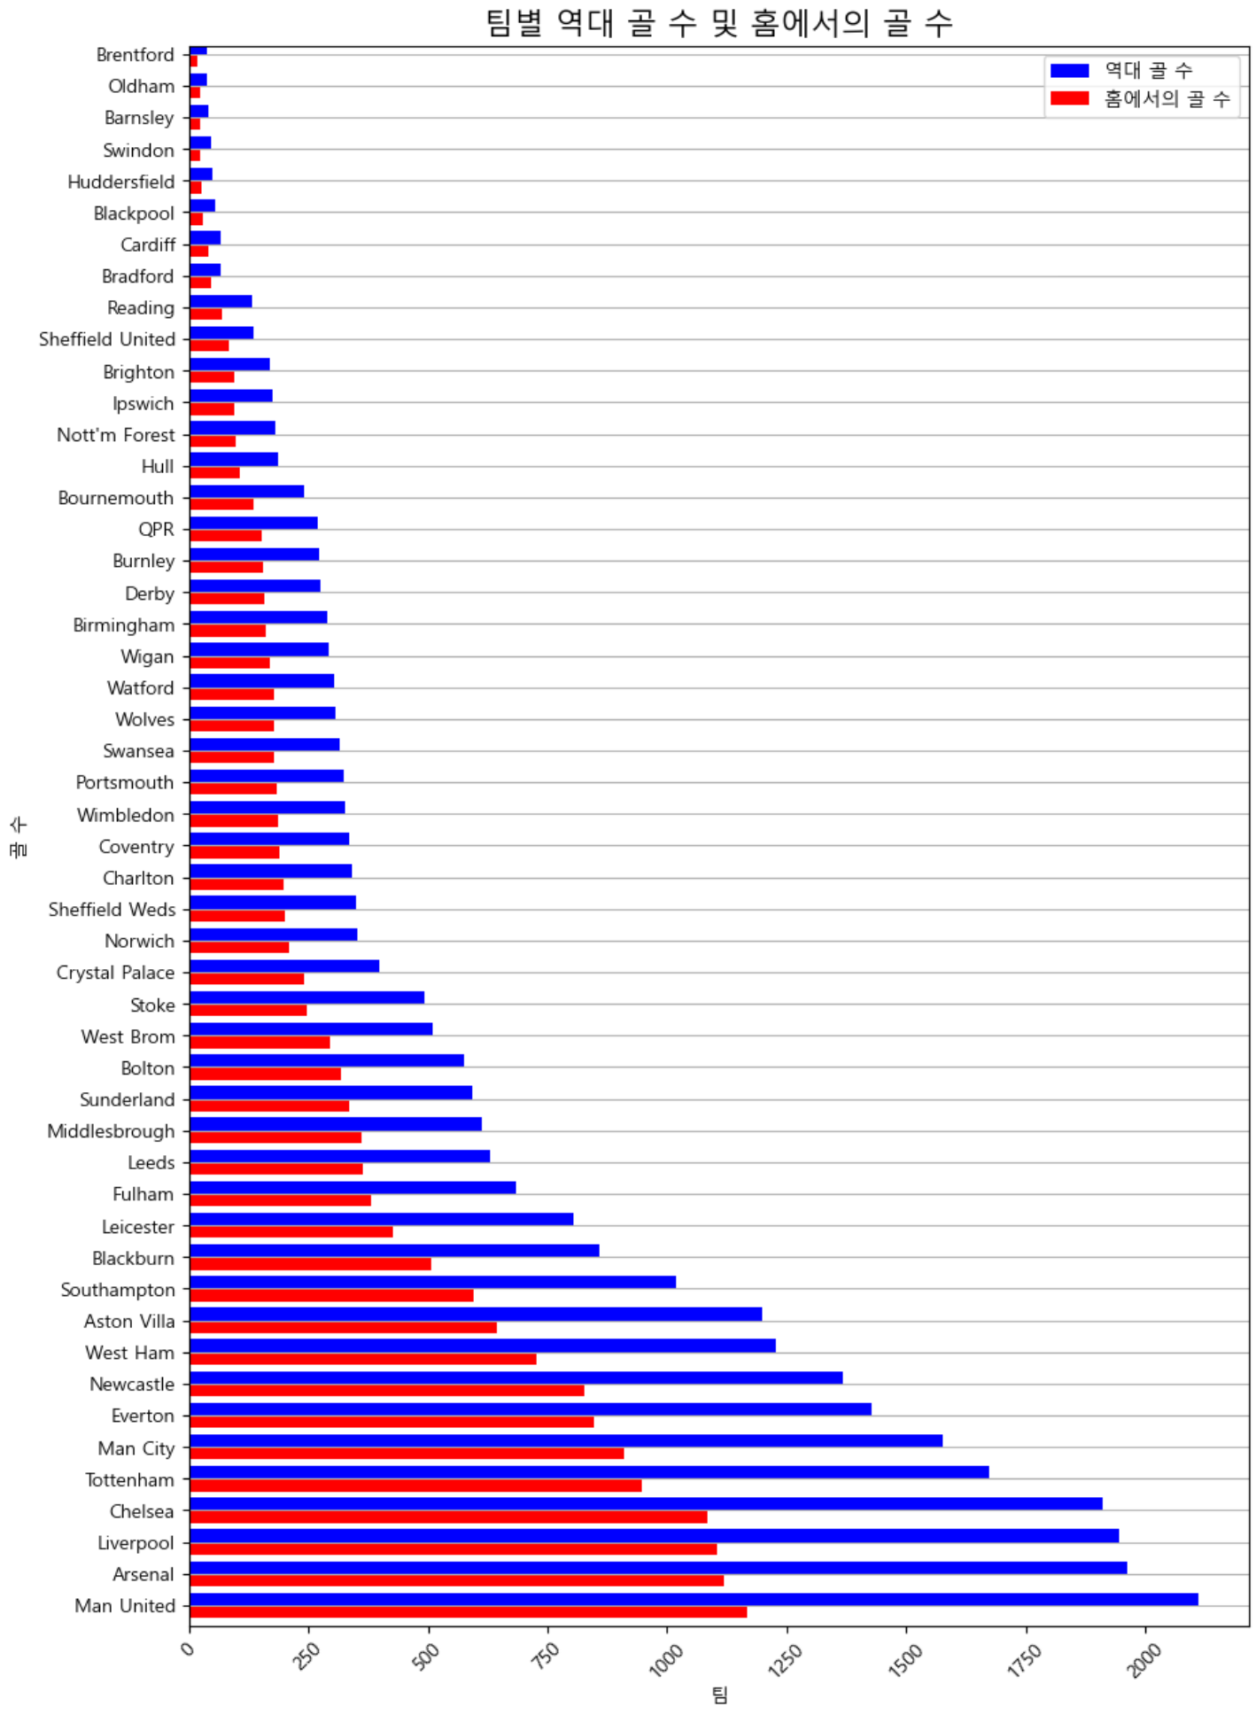
PPT PRESENTATION
Enjoy your stylish business and campus life with BIZCAM

Slide 10
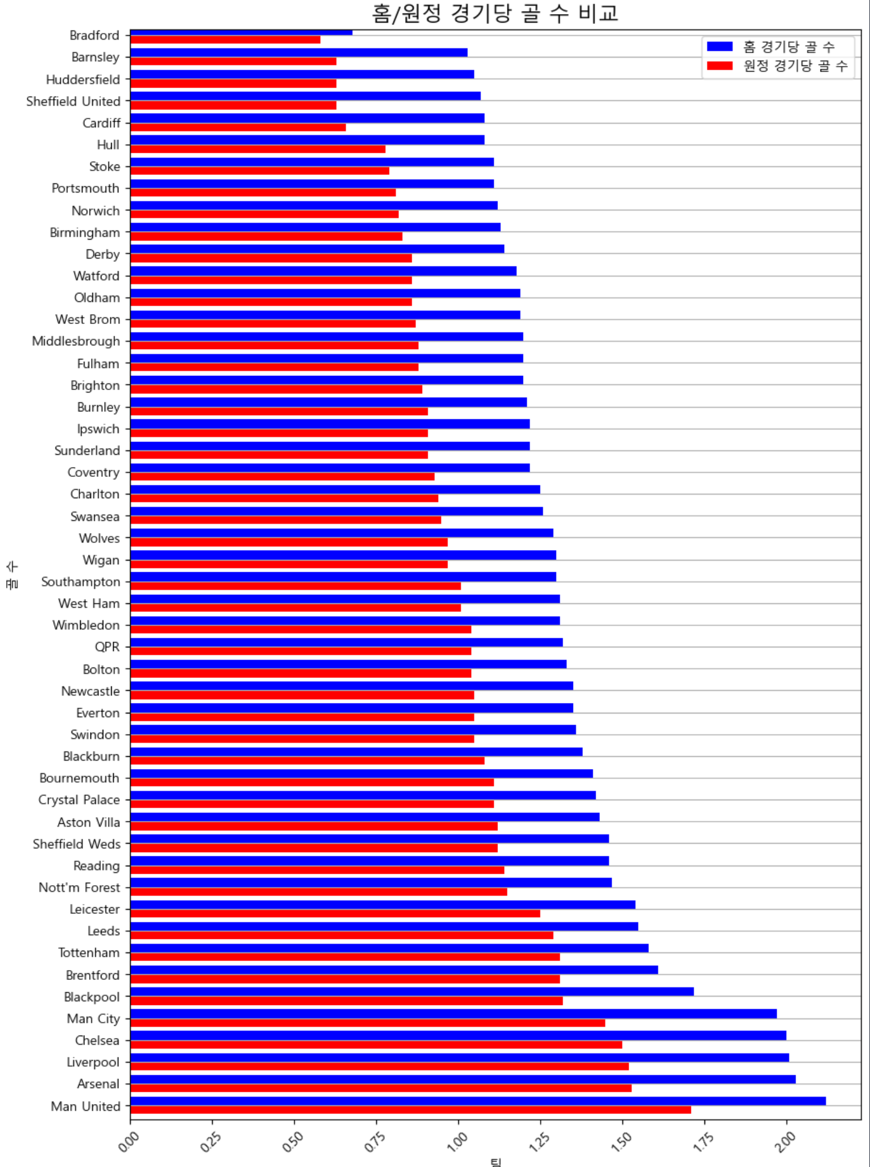
PPT PRESENTATION
Enjoy your stylish business and campus life with BIZCAM

Slide 11
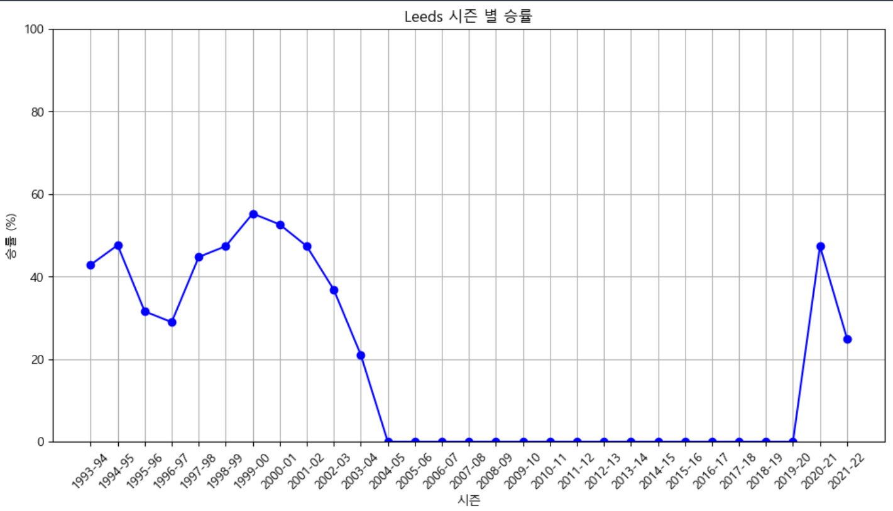
PPT PRESENTATION
Enjoy your stylish business and campus life with BIZCAM

Slide 12
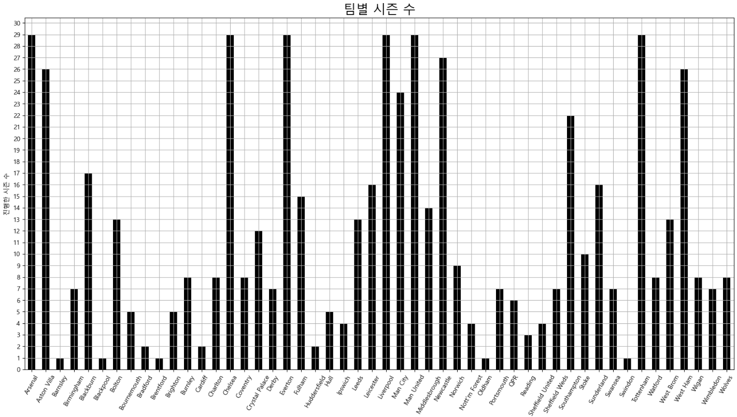
PPT PRESENTATION
Enjoy your stylish business and campus life with BIZCAM

Slide 13
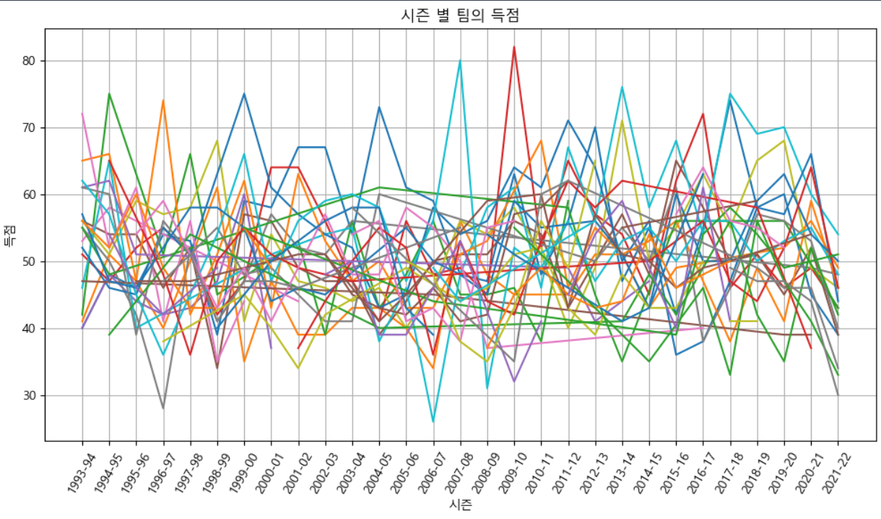
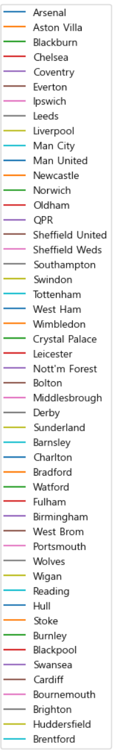
PPT PRESENTATION
Enjoy your stylish business and campus life with BIZCAM

Slide 14
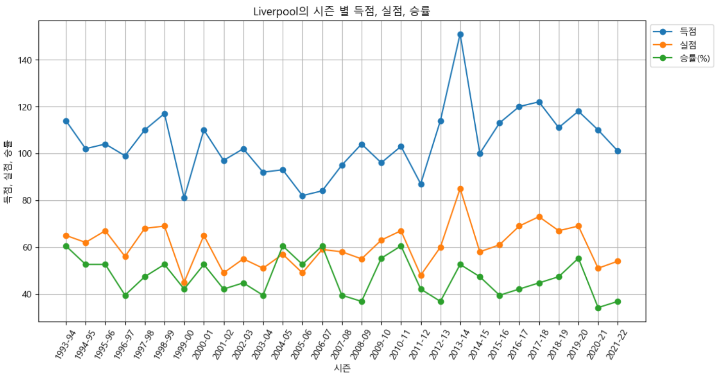
PPT PRESENTATION
Enjoy your stylish business and campus life with BIZCAM

Slide 15
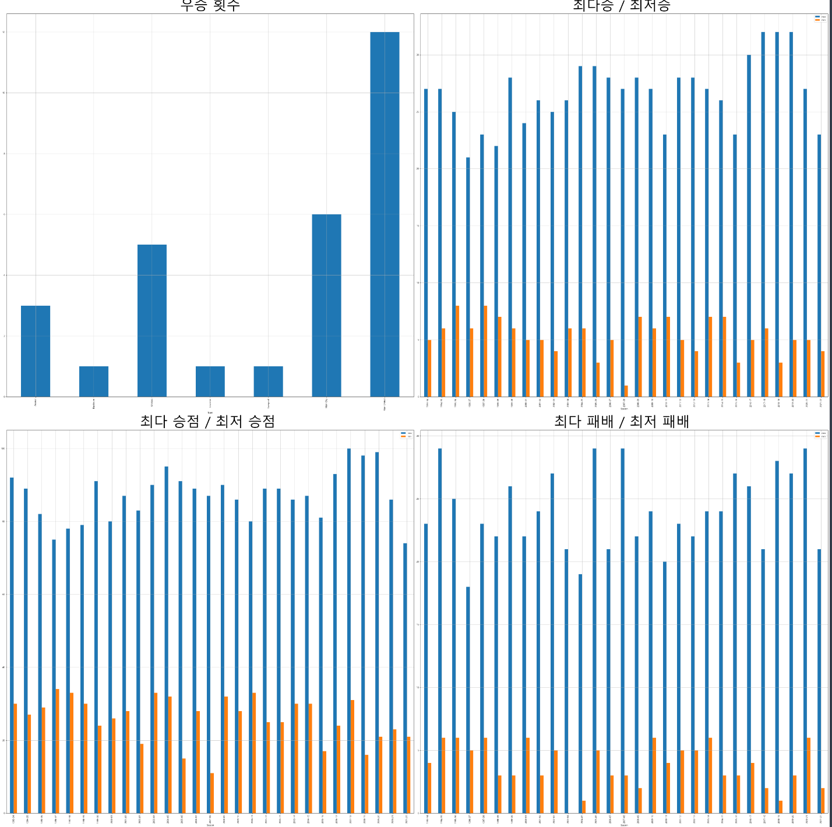
PPT PRESENTATION
Enjoy your stylish business and campus life with BIZCAM

Slide 16
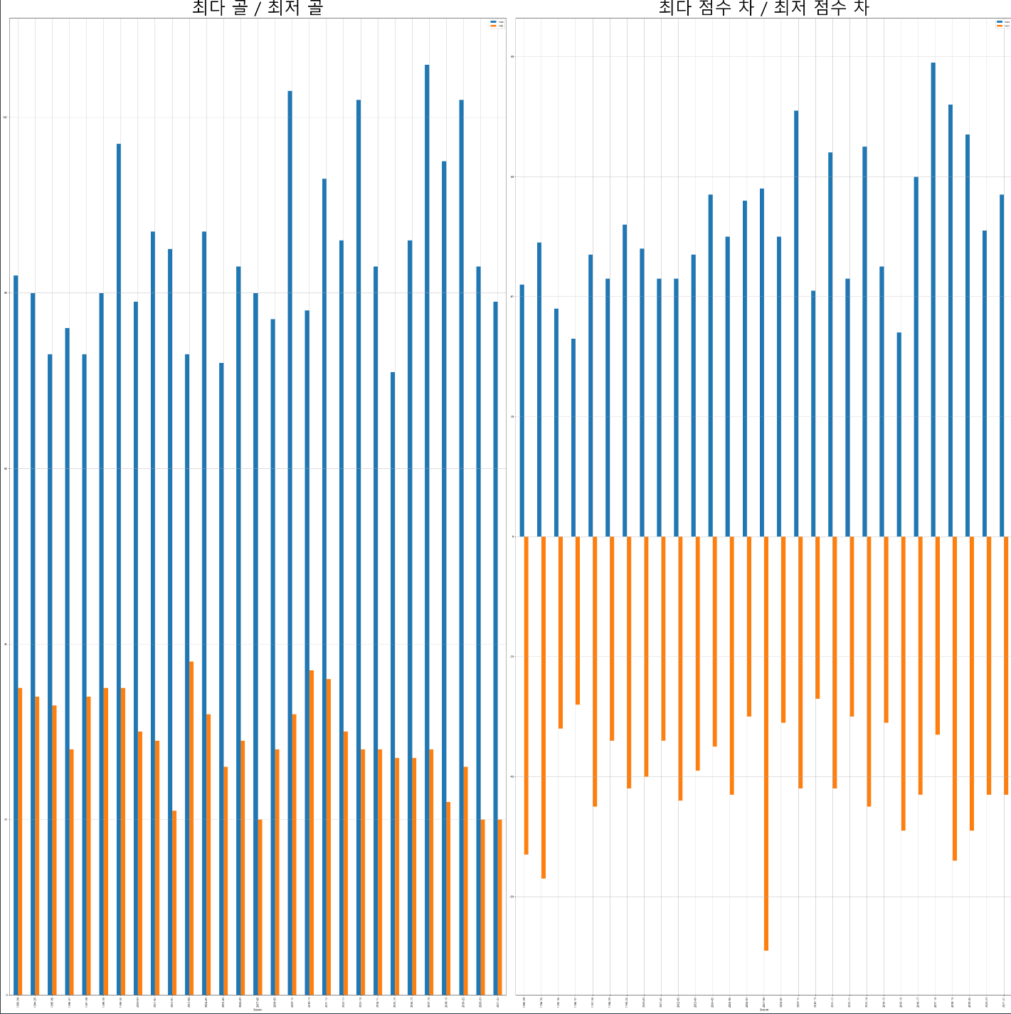
PPT PRESENTATION
Enjoy your stylish business and campus life with BIZCAM

Slide 17
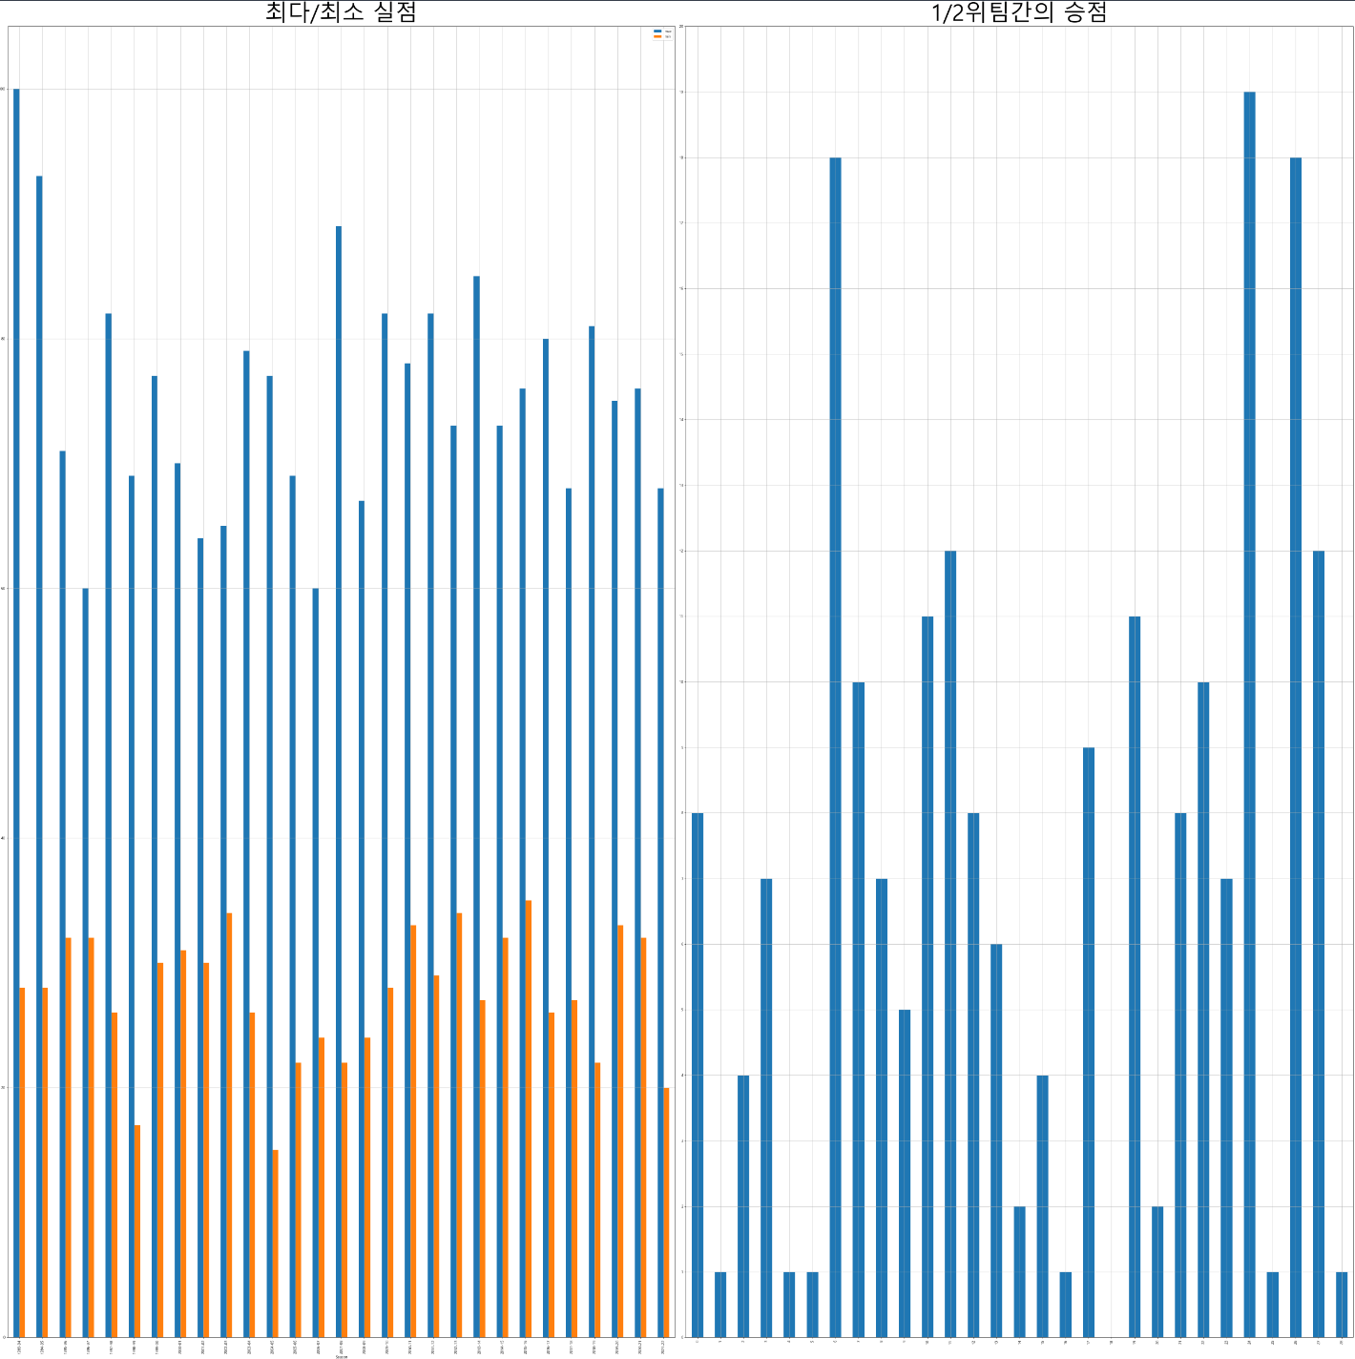
PPT PRESENTATION
Enjoy your stylish business and campus life with BIZCAM

Slide 18
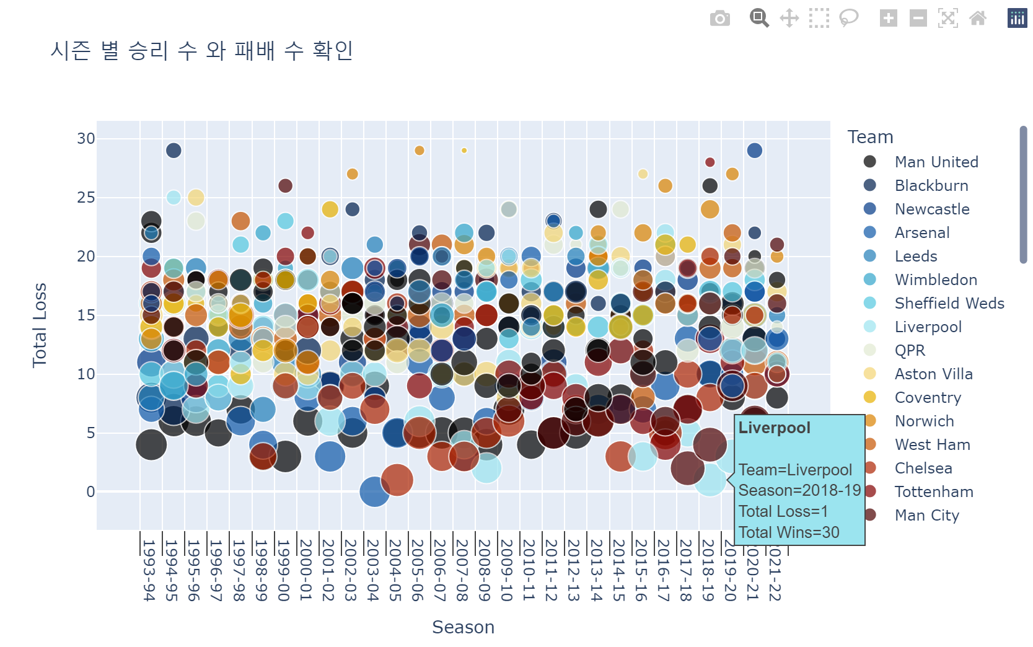
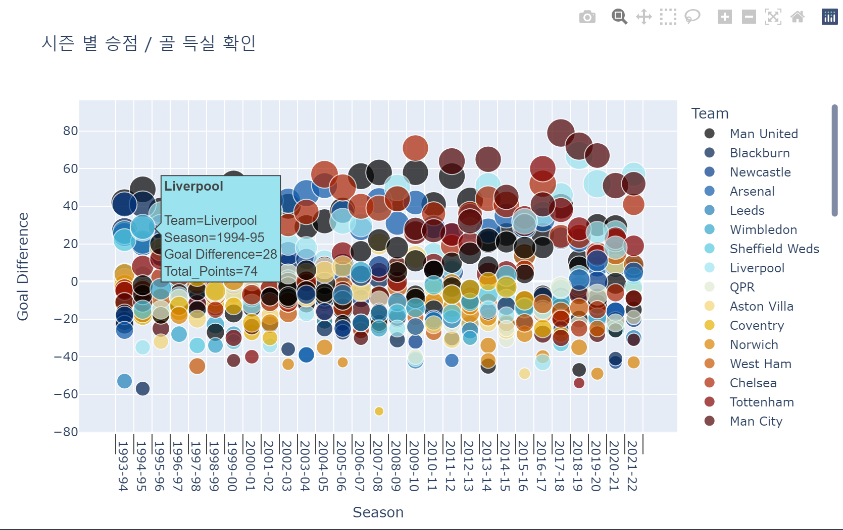
PPT PRESENTATION
Enjoy your stylish business and campus life with BIZCAM
한 시즌 최다 승리 2017-18맨시티 32승
한 시즌 최저 승리 2007-08더비카운티 1승
한 시즌 최다 패배 1994-95입스위치, 2005-06선덜랜 드, 2007-08더비카운티 29패
한 시즌 최저 패배 2003-04아스날 0패
한 시즌 최다 승점 2017-18맨시티 100점
한 시즌 최저 승점 2007-08더비카운티 11점
한 시즌 최다 골 득실 2017-18맨시티 79점
한 시즌 최저 골 득실 2007-08더비카운티 -69점

Slide 19
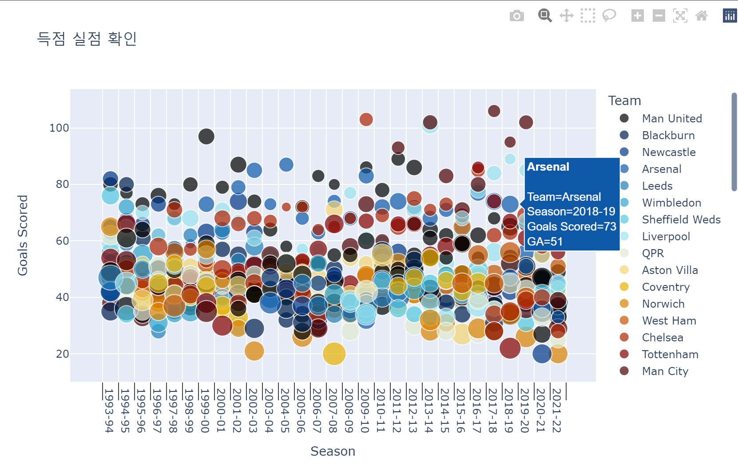
PPT PRESENTATION
Enjoy your stylish business and campus life with BIZCAM
단일 시즌 최다 골 2017-18 맨시티 106골
단일 시즌 최저 골 2007-08 더비카운티 20골
단일 시즌 최다 실점 1993-94 스윈던 100골
단일 시즌 최저 실점 2004-05 첼시 15골

Slide 20
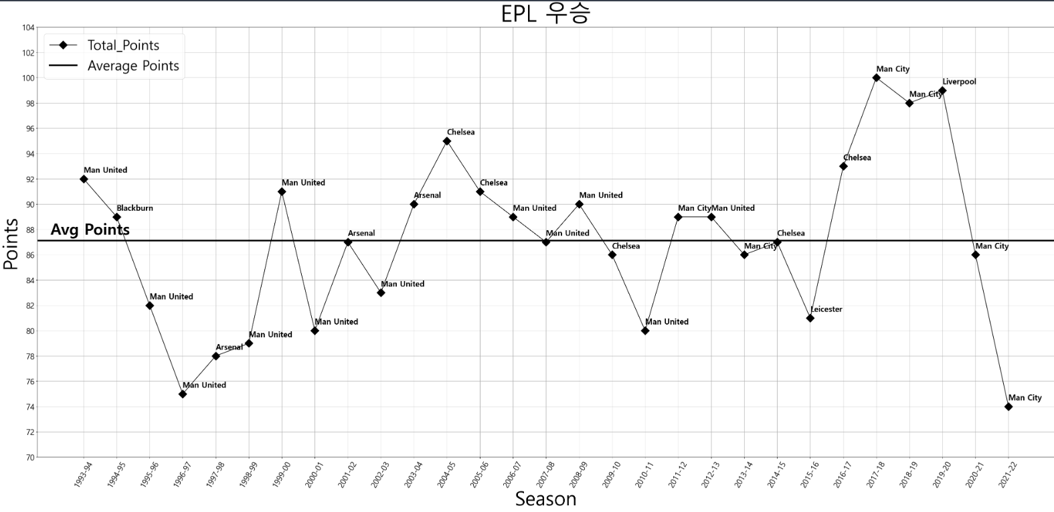
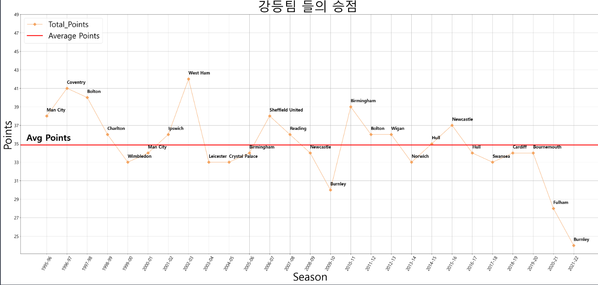
PPT PRESENTATION
Enjoy your stylish business and campus life with BIZCAM

Slide 21
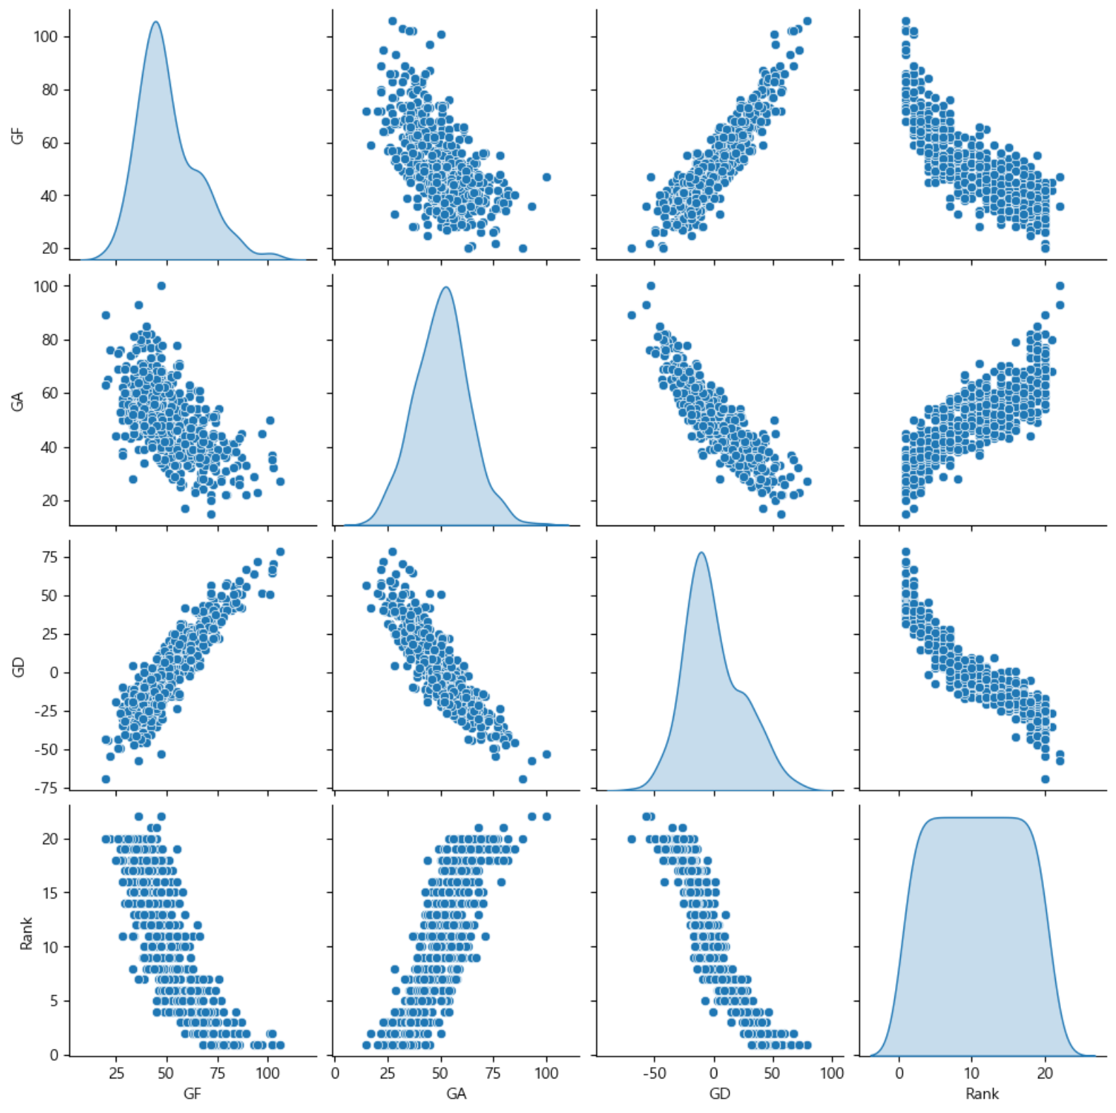
PPT PRESENTATION
Enjoy your stylish business and campus life with BIZCAM
리그에서는 골 득실, 실점, 득점, 팀 순위 간에 강한 상관 관계가 있다.
팀 득점이 많아 질수록 순위가 내려가고
실점이 많을수록 순위는 상승합니다.
승리를 위해서는 골을 많이 넣고 적게 실점 즉, 골득실이 높아야 순위가 낮아집니다.
순위가 낮다는 것은 1위를 의미합니다.

Slide 22
PPT PRESENTATION
Enjoy your stylish business and campus life with BIZCAM

Slide 23

POWER POINT PRESENTATION
Enjoy your stylish business and campus life with BIZCAM

Slide 24

POWER POINT PRESENTATION
FIFA U20 월드컵 축구 대표팀!! 우승하자!!
Enjoy your stylish business and campus life with BIZCAM

Slide 25
POWER POINT PRESENTATION
FIFA U20 월드컵 축구 대표팀!! 우승하자!!
Enjoy your stylish business and campus life with BIZCAM

Slide 26
2019. 12월 기준 시장 점유율 순위
컨텐츠에 대한 내용을 적어요 Enjoy your stylish business and campus life with BIZCAM
순위 | 회사명 | 점유율
1 | PPTBIZCAM | 52%
2 | B일렉트로닉 | 17%
3 | C엔터테인먼트 | 15%
4▲(1) | D 매니지먼트 | 8%
5 | E 케미컬 | 5%
6 | F 에너지 | 2%
7 | G 전자 | 1%

Slide 27
PPT PRESENTATION
Enjoy your stylish business and campus life with BIZCAM
90:00 FT

Slide 28
PPT PRESENTATION
Enjoy your stylish business and campus life with BIZCAM
90:00 FT

Slide 29
PPT PRESENTATION
Enjoy your stylish business and campus life with BIZCAM
CONTENTS A
You can use a software program such as Microsoft Power Point to provide the audience with slides that contains your major points or essential information.
54.5% 상승
2021년 6월 평균
CONTENTS A
You can use a software program such as Microsoft Power Point to provide the audience with slides that contains your major points or essential information.

Slide 30
PPT PRESENTATION
Enjoy your stylish business and campus life with BIZCAM
90:00 FT

Slide 31
KFA
Korea Football Association

Slide 32
PPT PRESENTATION Enjoy your stylish business and campus life with BIZCAM
PowerPoint is a computer program created by Microsoft Office
Microsoft Office PowerPoint is the presentation program used the most in the world.
천제 평균

Slide 33
PPT PRESENTATION Enjoy your stylish business and campus life with BIZCAM
CONTENTS. A
75%
CONTENTS. A
75%
Enjoy your stylish business and campus life with BIZCAM
Enjoy your stylish business and campus life with BIZCAM
CONTENTS. A
75%
CONTENTS. A
75%
Enjoy your stylish business and campus life with BIZCAM
Enjoy your stylish business and campus life with BIZCAM

Slide 34
PPT PRESENTATION Enjoy your stylish business and campus life with BIZCAM

